Slide 1



Summary of BURN GAS BUSINESS MODEL
Victor Onyeaghala
Data Analyst

Slide 2


Agenda
Project recap
Problem
Process
Insights
Summary
Recommendation

Slide 3


Burn Gas operates using a “Razor and Blades” business model and requires insight from their existing customer data to determine what steps to take to increase revenue generation.
Which Channel of sale is most effective and efficient?
Trend in Monthly Rate and Retention ratio per neighborhoods?
Relationship between Retention and Cohorts
Project Recap

Slide 4


Problem
Understand and generate insight from previous customer Data to help increase Revenue Generation

Slide 5

Understanding the Problem Statement
1
Process
Data Wrangling
2
Exploratory Data Analysis
3
Testing Hypothesis
4
Data Visualization
5

Slide 6
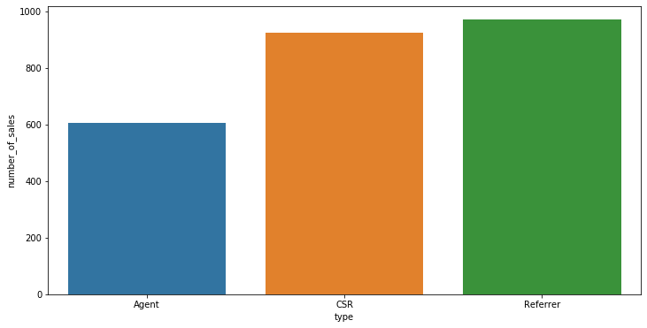


Insights
From the result gained through analysis, it is clear that:
- More Sales OF BURN cookers were made through the Referrer channel and CSR channels than through the Agent channel

Slide 7
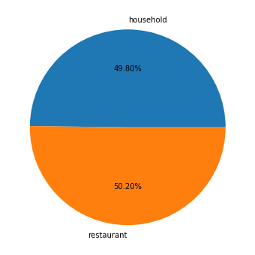
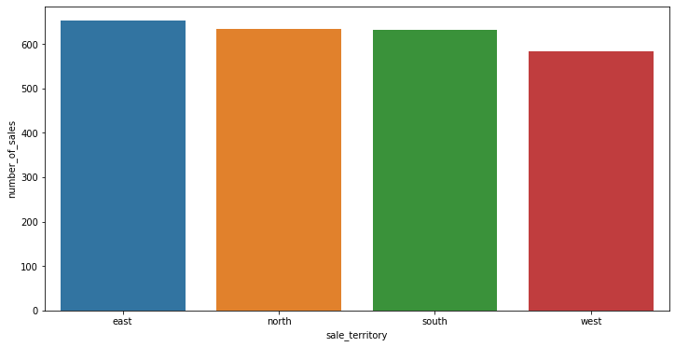
Insights
-About the same number of cookers sold to both Restaurants and Households, but restaurants sells a little more
- Referrers in the East and South sell more cookers than those in the West and North
- CSR sell more cookers in the East, North and West
- Agents get more sales in the North, East and South

Slide 8
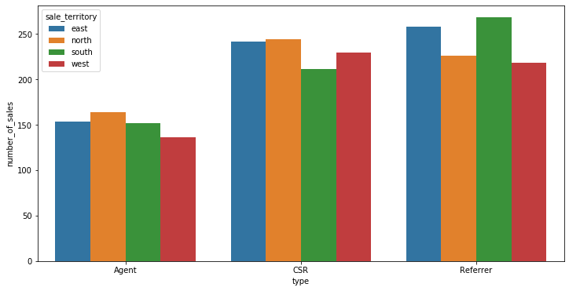
Insights

Slide 9
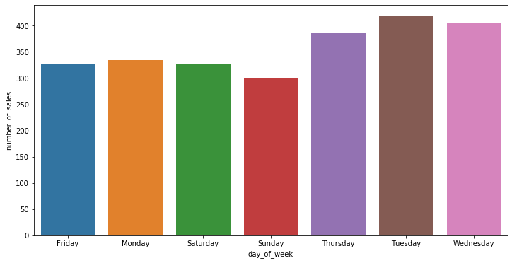
Insights
More sales are being made on Tuesday, Wednesday and Thursday Sundays has the least amount of sales
- Referrers make most of their sales on Wednesday and less on Sunday
CSR make most of their sales on Tuesday and least on Friday
- Agents make most of their sales on Thursday and least on Wednesday

Slide 10
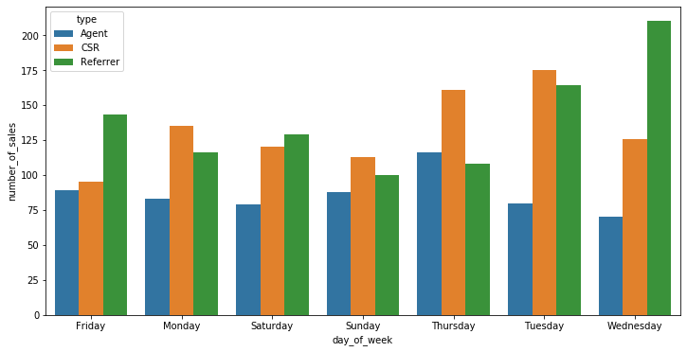
Insights

Slide 11
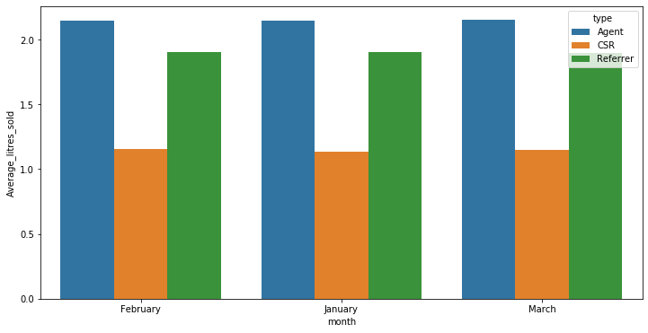
Insights
More sales are being made on Tuesday, Wednesday and Thursday Sundays has the least amount of sales
- Cookers sold through the Agent channels purchases more fuel per month than cookers sold through CSR channels
Observation
Agents sell BURN cookers and gas to consumers who are more likely to consume more BURN fuel, for example, selling to more industrial restaurants who cook more often than an average restaurants and households with more individuals in them
CSR channel sells more cookers but fuel consumption is low probably due to the fact that they sell to restaurants and individuals who do not cook that often
Referrers sells to both household and restaurants who buy more cookers and also buy fuel required for them (A balanced structure)

Slide 12
From the result gained through analysis, it is clear that:
Referrer's channel is the most productive and most efficient; company doesn't have to pay for training of these individuals and just commissions are paid for products sold
Therefore more sales from this channel means more revenue from the company at only a cost of commissions being paid to these referrers
Additional datasets required
How many restaurants and households are in that city,
The kind of restaurants that buy BURN cookers would be helpful, so as to determine which set of customers the BURN cooker would be suitable for
Average price of BURN cookers to other cookers, and BURN Fuel to other fuels
Summary

Slide 13
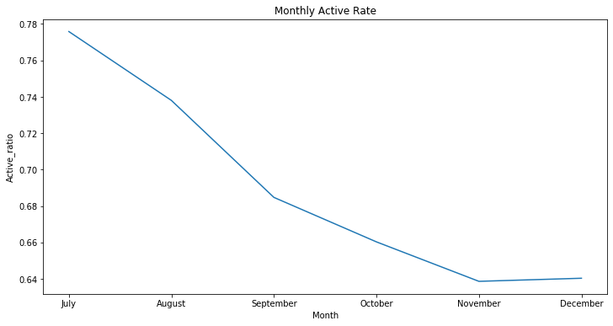
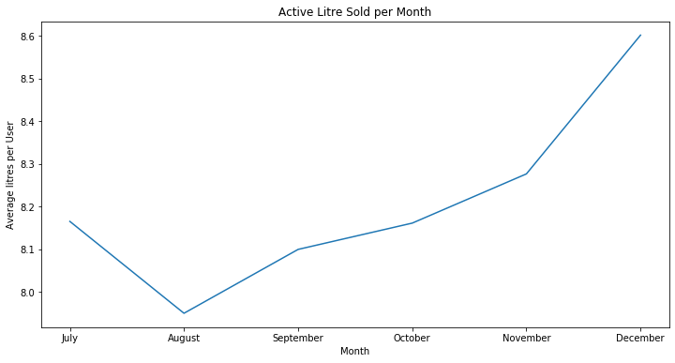
Insights

Slide 14
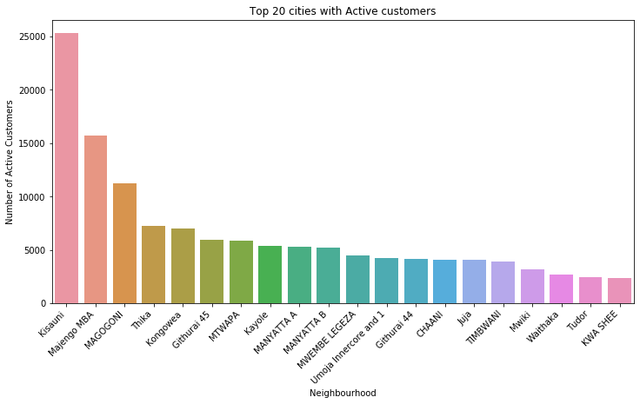
Insights

Slide 15
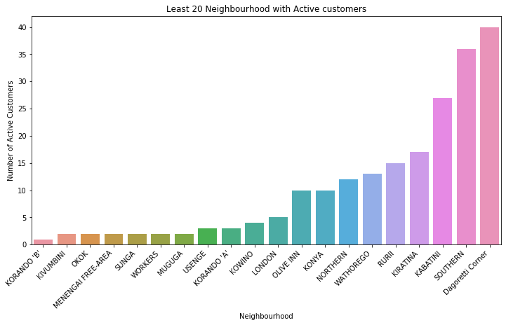
Insights

Slide 16
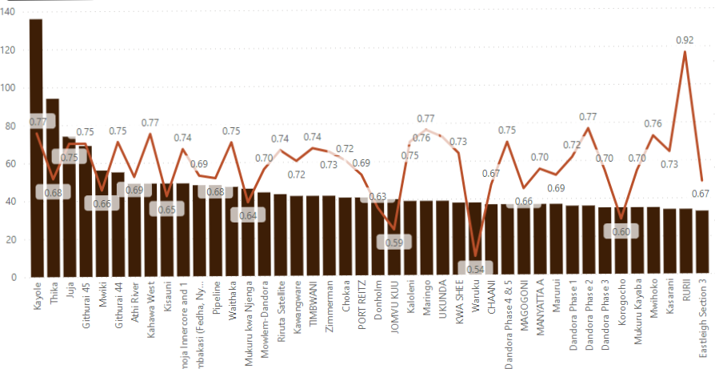
Insights

Slide 17
From the result gained through analysis, it is clear that:
Monthly Active rate reduces as month increases, yet the Average liter of burn fuel sold per month increases – assumptions are that household owners cook less yet Industrial owner get to cook more thus frequently purchasing more Burn fuel
Number of burn points has an effect on retention ratio, some neighborhoods which have large number of active customers with an un-matching number burn points tends to result in a low retention ratio.
There is an increasing trend in active customers from the first quarter to the second quarter of each year, then a decreasing trend from the second quarter to the fourth quarter of each year.
Kisauni has the highest number of active users with a total number of 25,285 active users, followed by Majengo MBA(15,727) and Magogoni (11, 190)
KORANDO 'B' has the lowest number of active users with a total number of 1 active user, followed by KIVUMBINI, OKOK, SUNGA(2)
Summary

Slide 18
More resources should be put into the referrer channel has it is the most productive and most efficient channel
Industrial Restaurants should be targeted as these seems to increase consumption of Burn Fuel
Top neighborhoods with more customers like Kisauni, Majengo MBA, and Magogoni should have more Burn Points in them so as to create a balance in demand-supply ratio and prevent customer churning
Recommendations

Slide 19

Thank you!
AVAILABLE TO ANSWER ANY QUESTIONS?

